Slide 1
Safety and Security
09/20/2017
IoT Sensors & Systems

Slide 2
Acoustic Shooter Localization
What was this paper about?

Slide 3
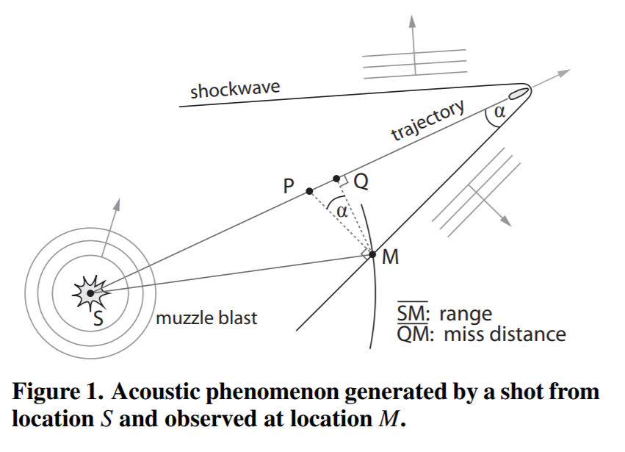
Shooter Localization Technique

Slide 4
Single vs. Multi Channel Sensors
What is the advantage of using single-channel sensors as opposed to multi-channel sensors?

Slide 5
Valid Conclusion?
“The demonstrated performance is excellent and it is due to the consistency function-based sensor fusion.” Is this conclusion valid?

Slide 6
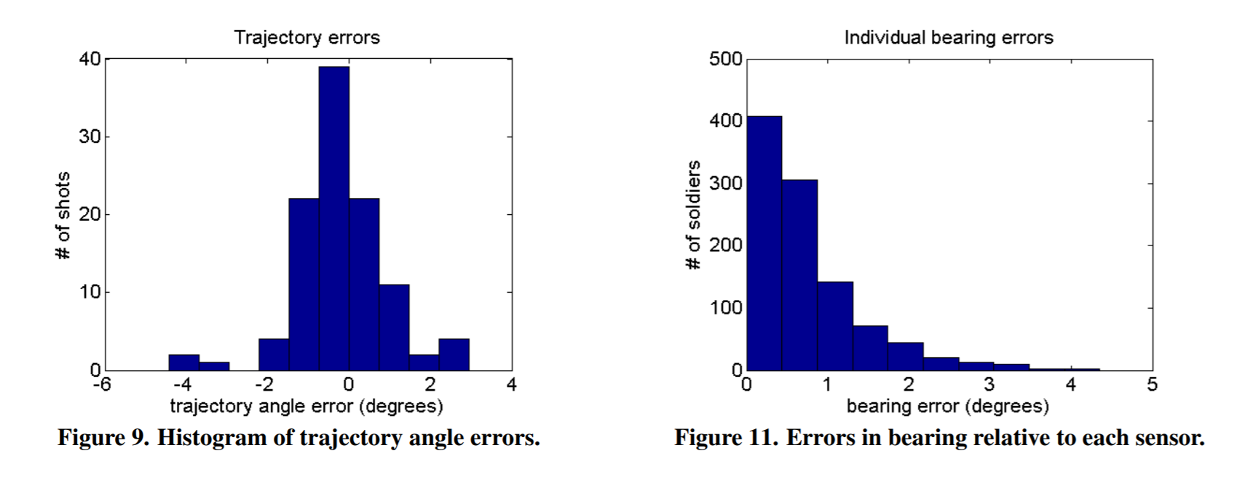
Results

Slide 7
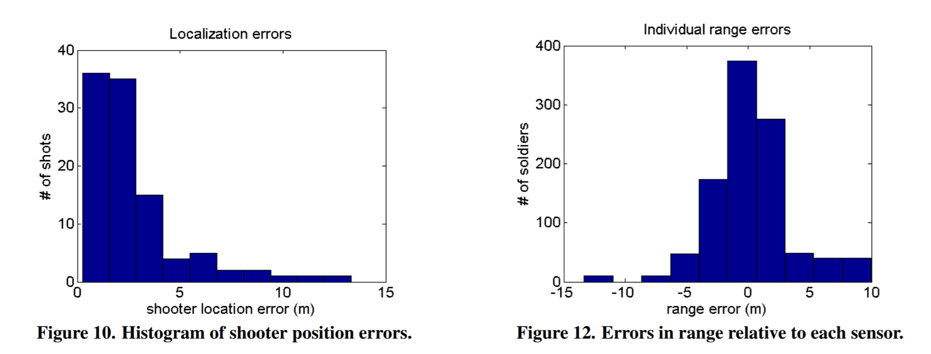
Results

Slide 8
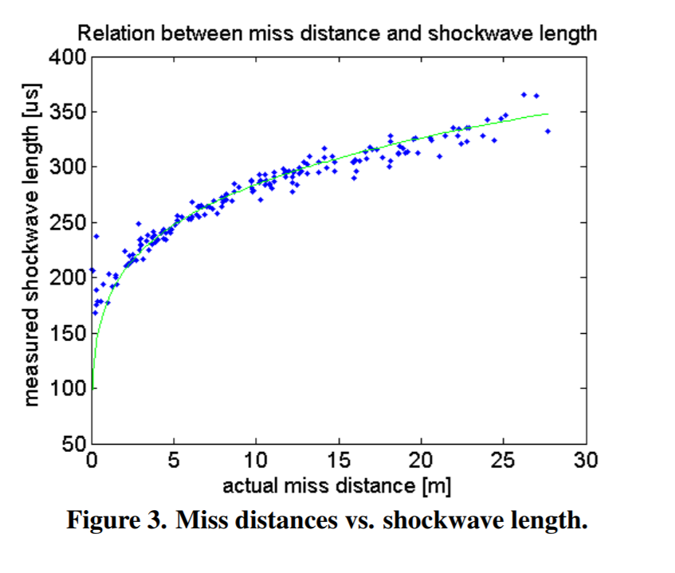
“The mean absolute range estimation error was 3.5 m [4.7%].”

Slide 9
Problems
What is the battery life on these devices? (Since they plan on using GPS in order to have very accurate timing (Sec. 4), this will probably reduce battery life significantly.)

Slide 10
Problems
If there is no network connection, the sensor must rely on only its own data to provide useful information. However, this information only includes range from the shooter, not bearing or weapon/caliber classification.

Slide 11
Problems
They need at least five single-channel wireless sensors to provide accurate information… is this reasonable? (In practice, they even mention that it would need more sensors to work reliably due to missed detections and blocked line-of-sight.)

Slide 12
Problems
Is requiring soldiers to use their smartphones to collect data gathered from the sensor feasible?

Slide 13
Problems
How will data look to the user? How useful will this data be to the soldier?

Slide 14
LookUp
What was this paper about?

Slide 15
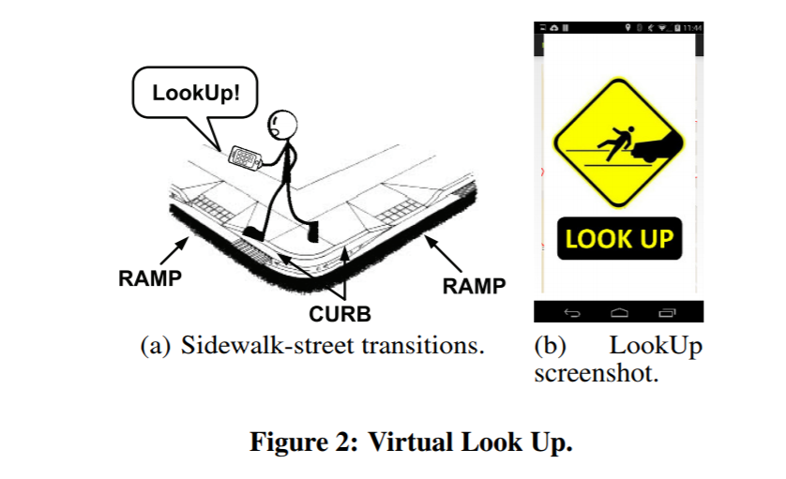
Diagram & App Screenshot

Slide 16
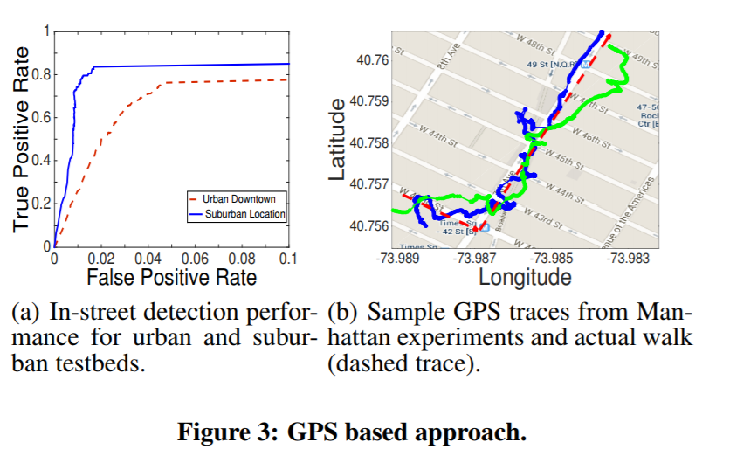
GPS Performance

Slide 17
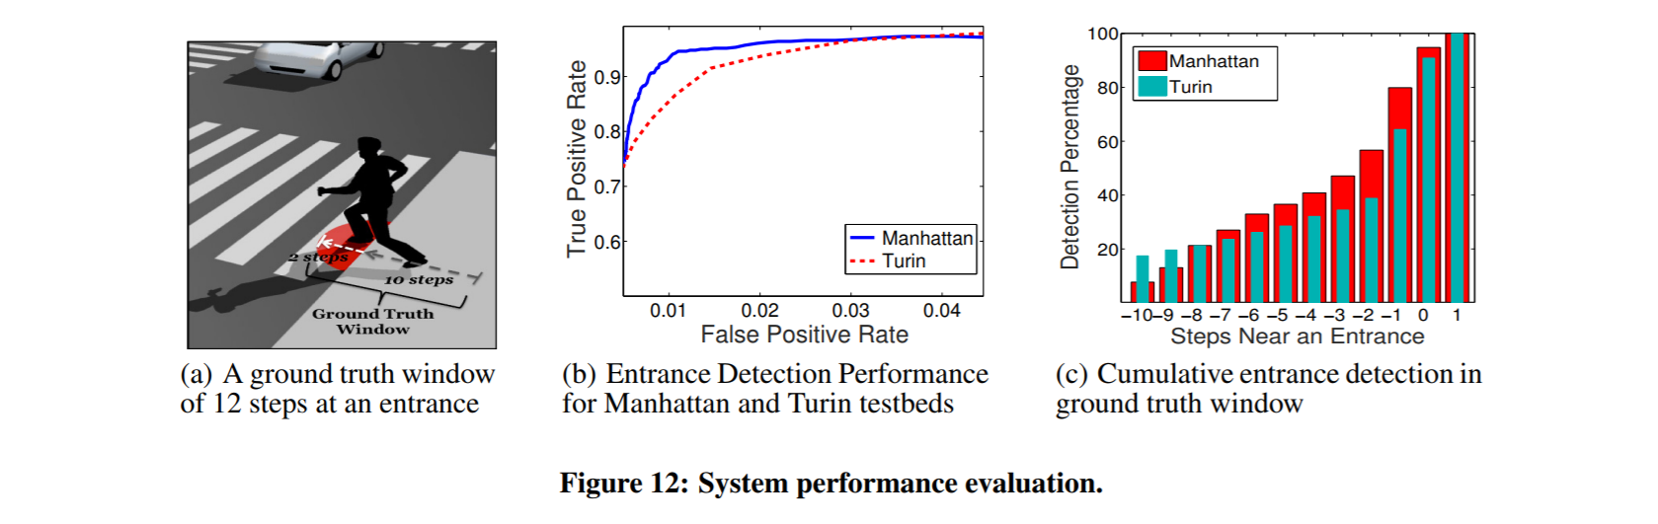
Results

Slide 18
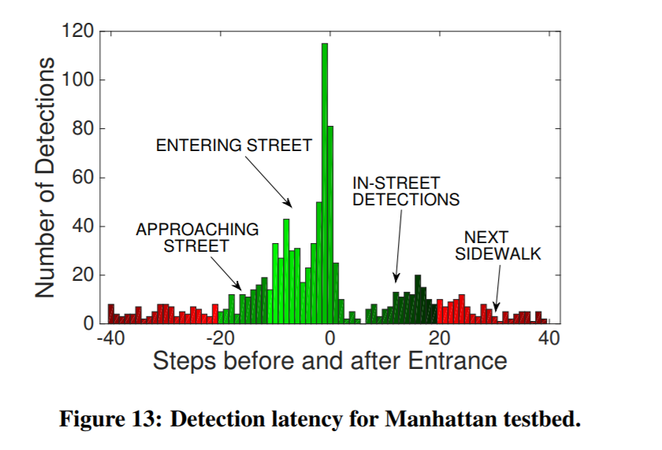
Results

Slide 19
Problems
“It senses small changes in the inclination of the ground, which are expected due to ramps and the sideways slope of roadways to faciliatate water runoff” (Sec. 4).

Slide 20
Problems
What is the battery life of the shoe sensor?

Slide 21
Problems: Impact
How likely is it that someone will wear a device on their shoe to be super safe on the streets?

